Slide 1

EMAIL AUTHENTICATION CHECKER TOOL – This tool checks the DMARC, SPF, and DKIM records for a list of domains and subdomains.
GPCSSI 2024 INTERN
CW-201 Jui Kalan
juikalan21@gmail.com

Slide 2
What does this tool do?
This tool is useful for ensuring email authentication policies are correctly configured to prevent phishing and spoofing attacks.
Checks DMARC, SPF and DKIM records for root domains and subdomains.
Shows results to the console.
Save results to a CSV file.

Slide 3
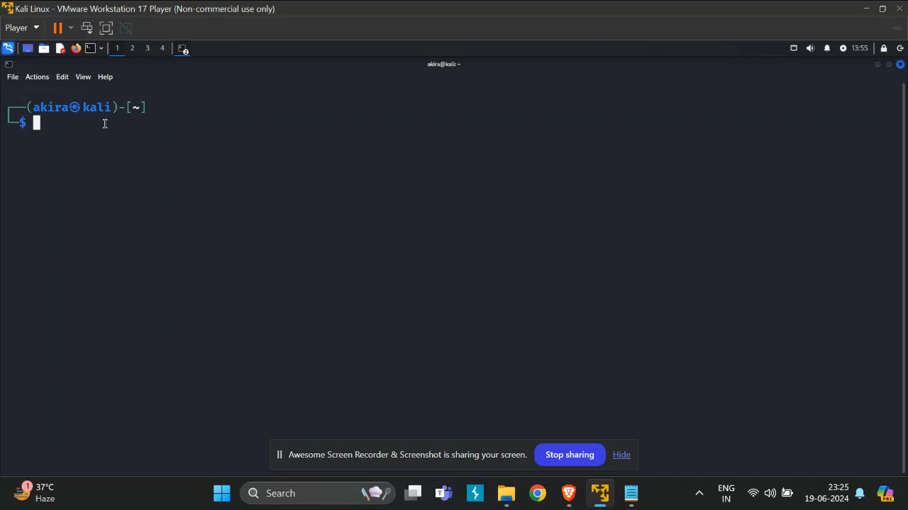

Slide 4
Use cases:
𝗘𝗺𝗮𝗶𝗹 𝗦𝗲𝗰𝘂𝗿𝗶𝘁𝘆 𝗔𝘂𝗱𝗶𝘁𝘀: Quickly scan multiple domains to verify DMARC, SPF, and DKIM records.
𝗠𝗮𝗻𝗮𝗴𝗲𝗱 𝗦𝗲𝗿𝘃𝗶𝗰𝗲 𝗣𝗿𝗼𝘃𝗶𝗱𝗲𝗿𝘀 (𝗠𝗦𝗣𝘀): Perform bulk email authentication checks for multiple client domains.
𝗗𝗼𝗺𝗮𝗶𝗻 𝗣𝗼𝗿𝘁𝗳𝗼𝗹𝗶𝗼 𝗠𝗮𝗻𝗮𝗴𝗲𝗺𝗲𝗻𝘁: Ensure secure email configurations across a large portfolio of domains.
𝗣𝗿𝗲-𝗔𝗰𝗾𝘂𝗶𝘀𝗶𝘁𝗶𝗼𝗻 𝗗𝘂𝗲 𝗗𝗶𝗹𝗶𝗴𝗲𝗻𝗰𝗲: Assess email security posture during mergers and acquisitions.

Slide 5
Use cases (contd):
𝗣𝗵𝗶𝘀𝗵𝗶𝗻𝗴 𝗔𝘁𝘁𝗮𝗰𝗸 𝗣𝗿𝗲𝘃𝗲𝗻𝘁𝗶𝗼𝗻: Prevent domain spoofing by validating email authentication records.
𝗖𝗼𝗺𝗽𝗹𝗶𝗮𝗻𝗰𝗲 𝗮𝗻𝗱 𝗥𝗲𝗴𝘂𝗹𝗮𝘁𝗼𝗿𝘆 𝗥𝗲𝗾𝘂𝗶𝗿𝗲𝗺𝗲𝗻𝘁𝘀: Verify email authentication for regulatory compliance.
𝗖𝗼𝗻𝘁𝗶𝗻𝘂𝗼𝘂𝘀 𝗠𝗼𝗻𝗶𝘁𝗼𝗿𝗶𝗻𝗴: Automate periodic checks of DMARC, SPF, and DKIM records.
𝗜𝗻𝗰𝗶𝗱𝗲𝗻𝘁 𝗥𝗲𝘀𝗽𝗼𝗻𝘀𝗲: Swiftly audit domains after phishing incidents to identify and fix gaps.

Slide 6
The technical stack:
The code is a bash script.
We have to create a domains.txt file with the list of domains and subdomains we want to check.

Slide 7

Thank you GPCSSI for giving me the opportunity to grow my skills. Jai Hind.

